Slide 2
Machine learning model solution
- CLUSTERING, CART & RANDOM FOREST

Slide 3
Objectives
Business problem: To identify amongst the existing customers of a bank who are more likely to take up personal loan , for effective cross-selling
Modeling objectives:
  Clustering : Create meaningful clusters from the population, to understand the nature of the customers
  Classification Tree model: Find rules to classify the customers for cross-selling, techniques to be used
    CART
    Random forest

Slide 4
Exploratory data analysis
Dataset provided has the following characteristics:
  No. of records: 5000
  No. of predictor variables : 13
    1 customer identifier column, which do not hold any statistical significance
    6 continuous numeric variables
    4 ordinal variables with 2 levels each
    2 ordinal variables with multiple levels
  Target variable : with 2 distinct classes , 0 for non-responders and 1 for no response
480 of 5000 customers responded positively, i.e. only 9.6% success rate

Slide 5
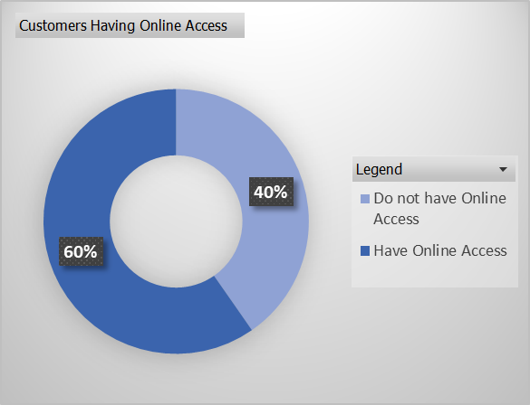
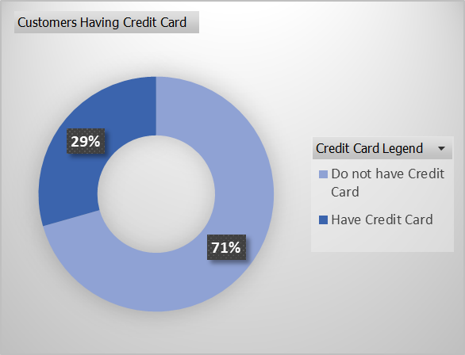
Data analysis : univariate – ordinal variables

Slide 6
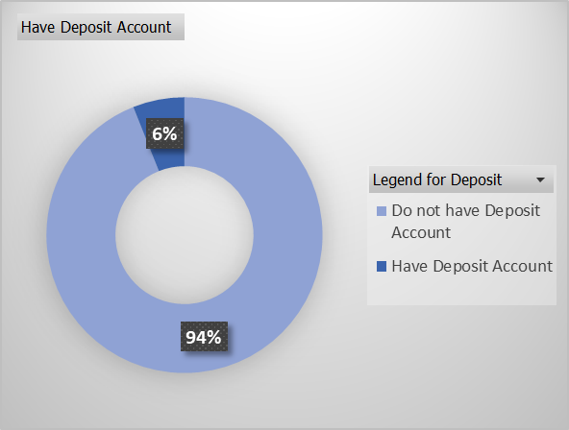
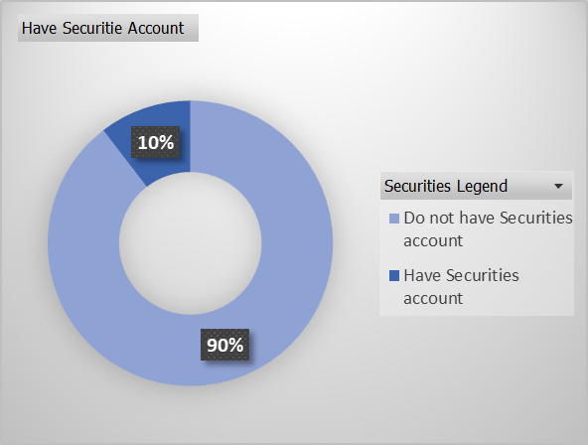
Data analysis : univariate – ordinal variables

Slide 7
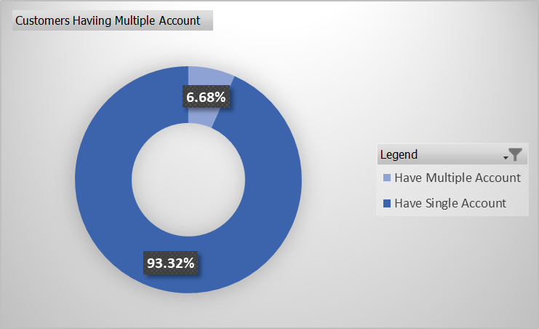
Data analysis : univariate – ordinal variables
Majority of the customers currently have only single relationship with the bank
Securities and deposit accounts are not very popular with the customers
Credit Card is the most popular product amongst all
Customers are open to internet banking facilities

Slide 8
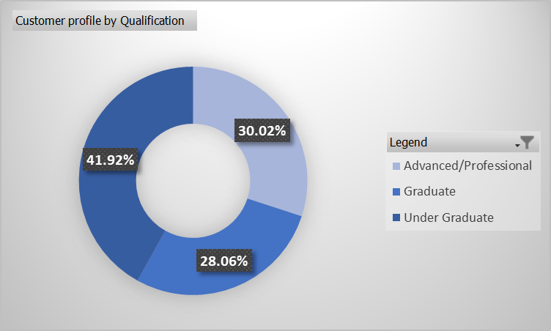
Data analysis : univariate – ordinal variables
Distribution of customers by their educational qualification is mostly uniform

Slide 9
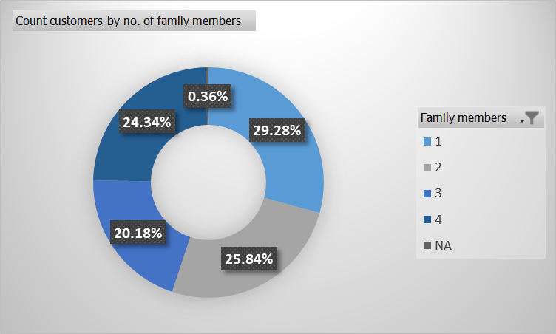
Data analysis : univariate – ordinal variables
Distribution of customers by number of family members they have
Since only 0.36% percent of records have NA will exclude these records from further analysis

Slide 10
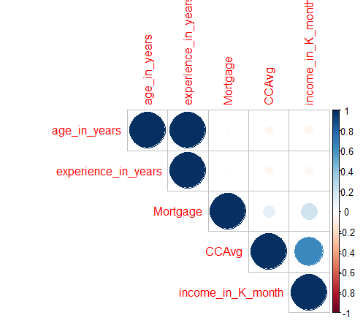
Data analysis : multivariate – continuous variables
There is high degree of correlation between customer age and years of professional experience, which is as per expectation
Will exclude experience years from next steps f analysis
People with high income tend to spend more on credit card per month , which is also as per expectation, but correlation is just about 0.4 so will keep both these variables

Slide 11
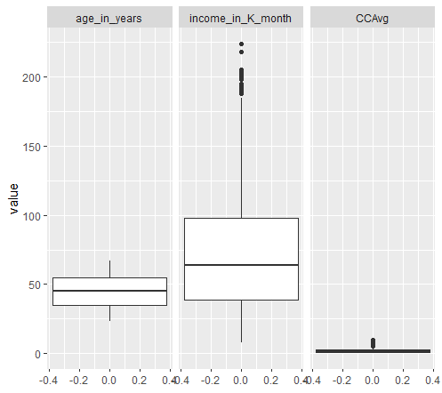
Data analysis : univariate – continuous variables
Distribution of Age is normal
Income and Credit card average spending per month have outliers
These variables need to be scaled

Slide 12
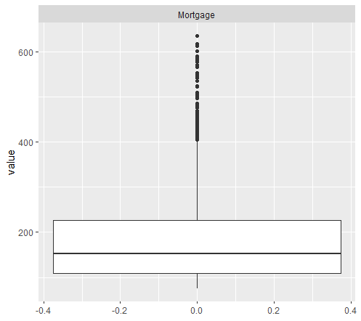
Data analysis : univariate – continuous variables
Check on records where home mortgage value is greater than 0 , shows that there are quite a number of outliers

Slide 13

Data analysis : Treatment of zip code
There are unique 467 zipcodes in the dataset
Since Zipcode as a number do not have any significance will treat it as a factor
To reduce the cardinality of Zipcode will aggregate it to State level
Since majority of the zipcodes are of 5 digits assuming them to be from US , hence using “zipcode” package to map them to States
33 records are found to have invalid Zipcode, ignoring them , found only one record belonging to state AE and rest 4966 to CA
So we can safely assume that State do not contribute to target variable hence dropping zipcode column

Slide 14
Data transformations done
  Row filters :
    Records with family member count not specified (18 of 5000)
  Column Filter :
    ID
    Zipcode
    Professional experience years
  Columns scaled for clustering:
    Age
    Income
    CC Average spent
    House Mortgage amount
  Columns created:
    Have multiple relationships with bank (1 : Yes , 0:No)
    Have House Mortgage (1:Yes , 0 :No)

Slide 15
CLUSTERING

Slide 16
Algorithm choice rationale
  Since the number of records are running into thousands we should be avoiding hierarchical clustering methods
  We have both continuous and factor data with more than one levels available within independent variables, hence Euclidean distance function cannot be used
  Gower distance function will be used, which takes care of both the data types
  K-means algorithms cannot be used since it assumed Euclidean distance , hence PAM (partitioning around medoids) will be used which is a variant of k-means , but instead of always defaulting to Euclidean distance it can refer to custom distance function
  We need to provide the number of clusters to start with as input to this algorithm

Slide 17
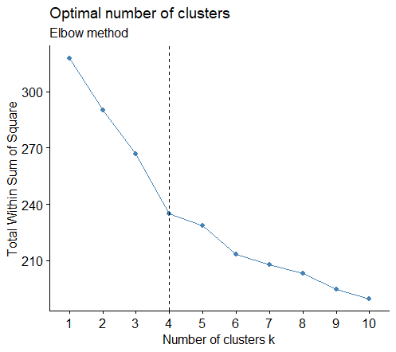
optimum number of clusters
  We have used the fviz_nbclust function from factoextra library to determine the optimum number of clusters, since this function is able to handle custom distance/dissimilarity function
  We will use the WSS / Elbow method to arrive at the optimum number of clusters

Slide 18
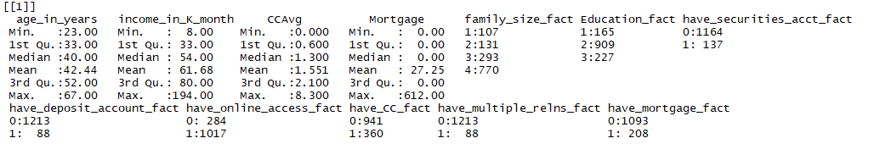
profiling clusters – Cluster 1
Characterized by
  Majority are Graduates
  Majority have online access
  Majority have 4 family members
  Majority do not have mortgage account

Slide 19
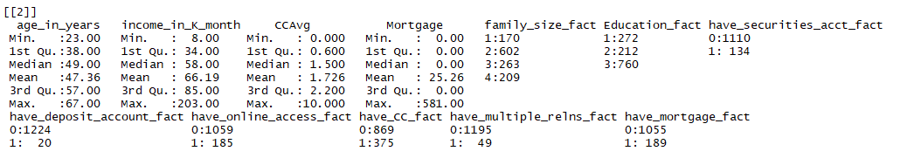
profiling clusters – Cluster 2
Characterized by
  Majority have advanced or professional degree
  Majority do not have internet banking access
  Majority have 2 family members
  Majority do not have any house mortgage

Slide 20
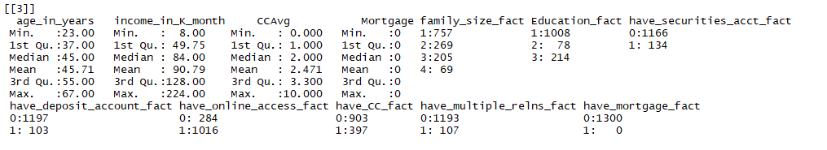
profiling clusters – Cluster 3
Characterized by
  Majority are undergraduates
  Majority have online access
  Majority have credit card accounts
  Majority have family size of 1
  None of them have any mortgage account

Slide 21
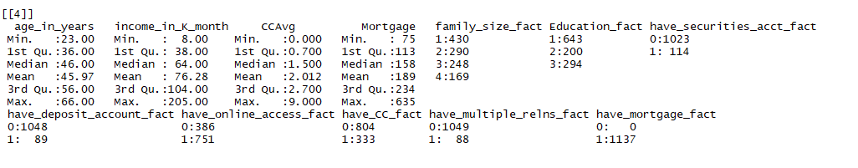
profiling clusters – Cluster 4
Characterized by
  Majority are undergraduates
  All of them have mortgage account
  Majority have internet banking access

Slide 22
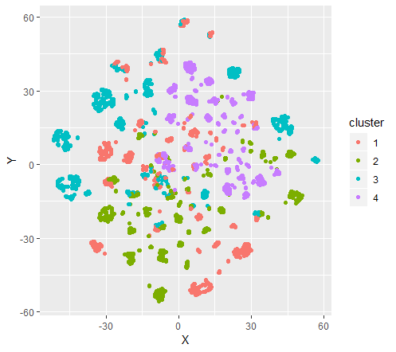
pictorial representation
We don’t see any good distinct clustering as from the picture
This is evident from the profiling also , since characteristics defining a cluster are not distinctive and overlapping on lots of aspects
There is a possibility of improving this cluster if we are taking some dimension reduction techniques

Slide 23
CLASSIFICATION

Slide 24
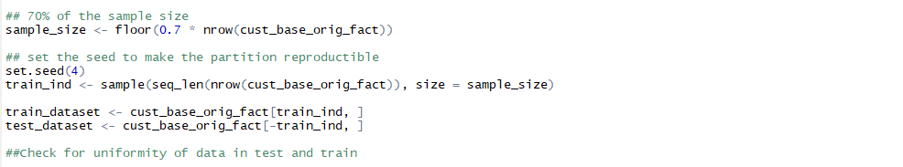
Test and train split
  Data is split into 70:30 ratio for train to test
  Response rate in split and overall data are close

Slide 25
CART

Slide 26
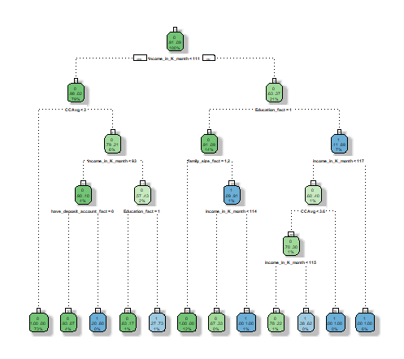
Initial tree
6% of the records are classified as responders in this node
73% of the records are classified as non-responders in this node

Slide 27
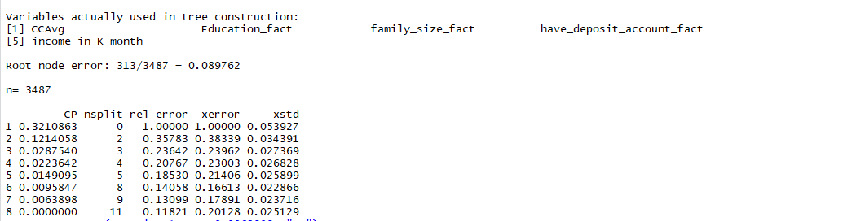

Prune tree
  Checking on the incremental reduction in error rate against increased complexity of the tree we see a divergence of error rate of test vs. train data at cp value indicated
  We will prune the tree with this complexity parameter to have the optimum tree

Slide 28
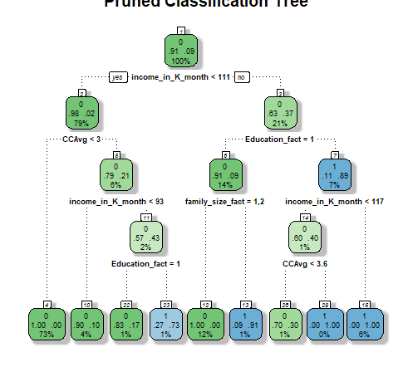
Final tree
  Here we have the final pruned tree with 29 nodes

Slide 29

Model performance measures
Deciling and rank-ordering the deciles give us the following results
  More than 90% of the records are accounted for in 10th and 9th deciles
  KS statistics is 0.93 (benchmark: >0.45) in the first decile itself which indicates overfit
  Lift calculated is also 9 in the first decile
Checking on other performance measures:
  AUC : 0.995953 (benchmark: >0.80)
  Gini : 0.9028706 (benchmark : >0.60)

Slide 30

Validate against holdout test data
Running the tree for test dataset created from the initial split gives the following results
  More than 90% of the records are accounted for in 10th and 9th deciles
  KS statistics is 0.92 (for train: 0.93) in the first decile itself
  Lift calculated is also 8.52 in the first decile
Checking on other performance measures:
  AUC : 0.9843769 (for train: 0.995953)
  Gini : 0.8873045 (for train : 0.9028706)
We see above that the performance measures in train and test are comparable , with not much deviation, hence we can conclude that this is a good model.

Slide 31
RANDOM FOREST

Slide 32
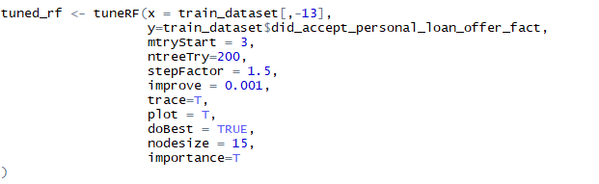
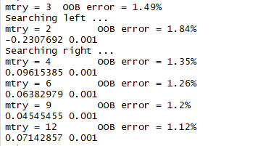
Initial model run
Started with these parameters given the guidelines
Suggests the out of bag error rate is lowest for mtry=12 so will run the model with that

Slide 33
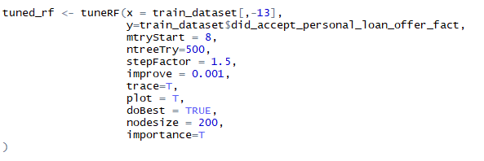
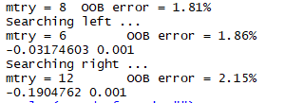
final model run
Through multiple iterations we see that these parameters give consistent output for multiple runs even on slight variations of the parameters
Suggests the out of bag error rate is lowest for mtry=8 so will stick to this

Slide 34
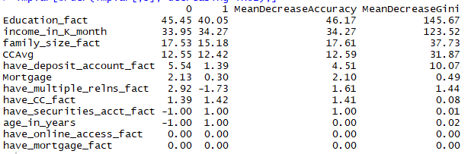
Checking for the importance of variables
We see that the 2 new variables added as part of feature engineering process do not have any significance
Top 4 most important variables helping in reducing impurity in each node is same as in CART model

Slide 35

Model performance measures
Deciling and rank-ordering the deciles give us the following results
  More than 100% of the records are accounted for in top 3 deciles
  KS statistics is 0.94 (benchmark: >0.45) in the first decile itself which indicates overfit
  Lift calculated is also 9 in the first decile
Checking on other performance measures:
  AUC : 0.995788 (benchmark: >0.80)
  Gini : 0.9005289 (benchmark : >0.60)

Slide 36
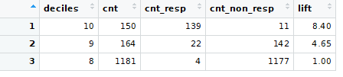
Validate against holdout test data
Running the tree for test dataset created from the initial split gives the following results
  All 100% of the records are accounted for in top 3 deciles
  KS statistics is 0.92 (for train: 0.93) in the first decile itself
  Lift calculated is also 8.42 in the first decile
Checking on other performance measures:
  AUC : 0.9809547 (for train: 0.995788)
  Gini : 0.8822665 (for train : 0.9005289)
We see above that the performance measures in train and test are comparable , with not much deviation, hence we can conclude that this is a good model.

Slide 37
conclusion
  CART and Random Forest have given the similar kind of variable importance output, so following variables play major role in identifying customers who are more likely to respond:
    Count of Family Members
    Education Level
    Income per month
  For both the model performance measurements give us high accuracy indicating overfit, but the model when validated against holdout sample gives comparable measurements
  Imbalanced nature of the data might lead to these observations, though decision trees are theoretically more immune to imbalanced data
  We need to take this model with a pinch of salt, and more data will be good
  Following approaches can be taken to make the model more reliable:
    Get more data from business
    Run the models after synthetically correcting for imbalance

Slide 38
THANK YOU

